Slide 1
Software Requirements Specification Courier Service System Prepared by Supervised by Showkat Ali Md. Rajaul Islam ID : 1247484 Used Technology Spring boot, Spring MVC, Spring Data JPA, Spring Security, Thymeleaf, InteliJ Idea & Hibernate

Slide 2
Air Shipping Services The organization also specializes in providing excellent Air Shipping Services to its clients. These are suitable for shipping of products and material via air, which is the faster mode of transportation. We also have associations with some of the reputed airline services for shipping. Some of the features of our air shipping services are as follows: Impeccable delivery time Fast and secured

Slide 3
Requirement
Allowing the customer to create an account
Allowing the customer to request a quote for a collection/delivery service.
Allowing the user to track Parcel from collection to the final destination.
Allowing the admin to register a new user.
Allowing the admin to add a new parcel location.
Allowing the Quotes for different Parcel Types.
Accept/Reject Customer Request.
View the different types of Quotes.
Adding the Branches for different Warehouses.
Allowing the user change his/her personal details.

Slide 4
Requirement ANALysis
the customer to create an account
the customer to request a quote for a collection/delivery service.
the user to track Parcel from collection to the final destination.
the admin to register a new user.
the admin to add a new parcel location.
the Quotes for different Parcel Types.
Accept/Reject Customer Request.
Adding the Branches for different Warehouses.
the user change his/her personal details.

Slide 5
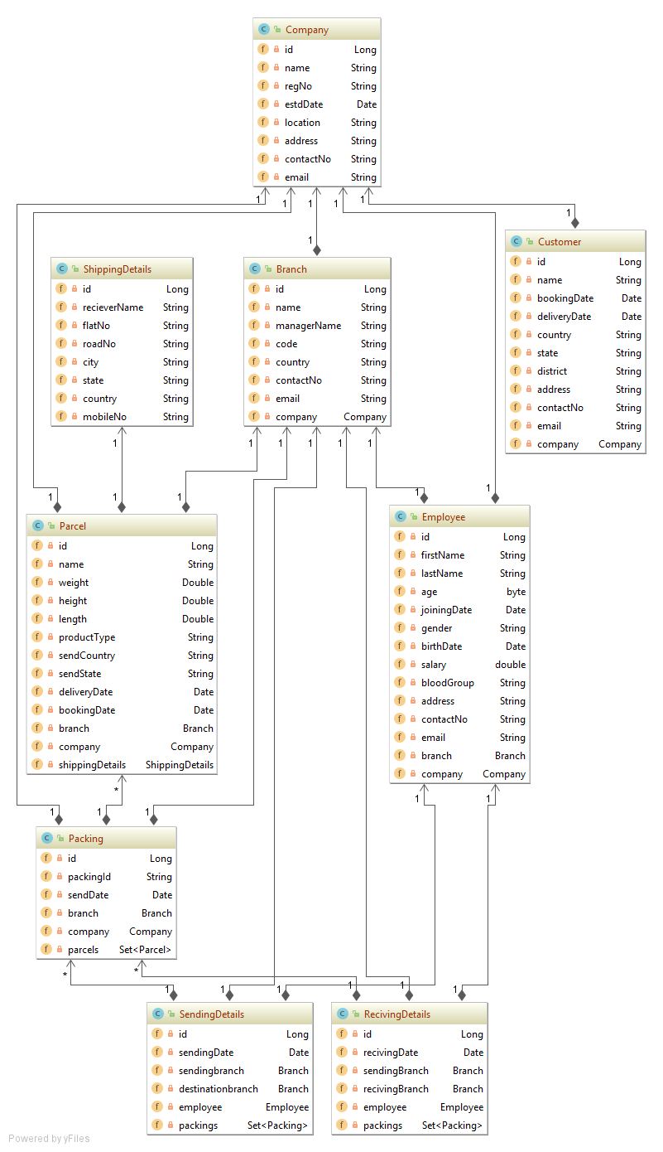
Class DiaGram

Slide 6
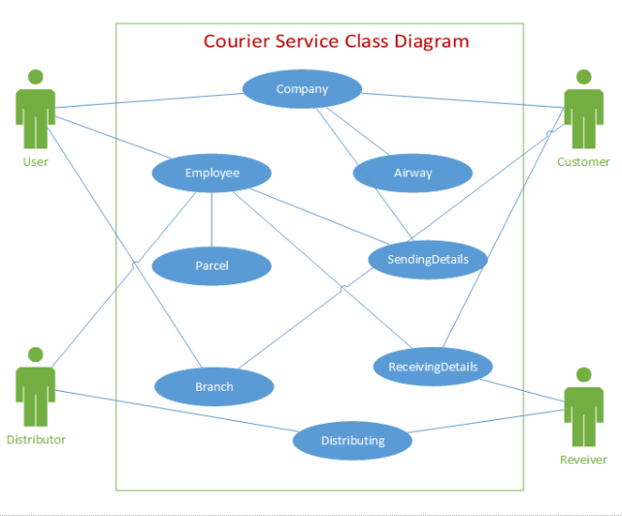

Slide 7
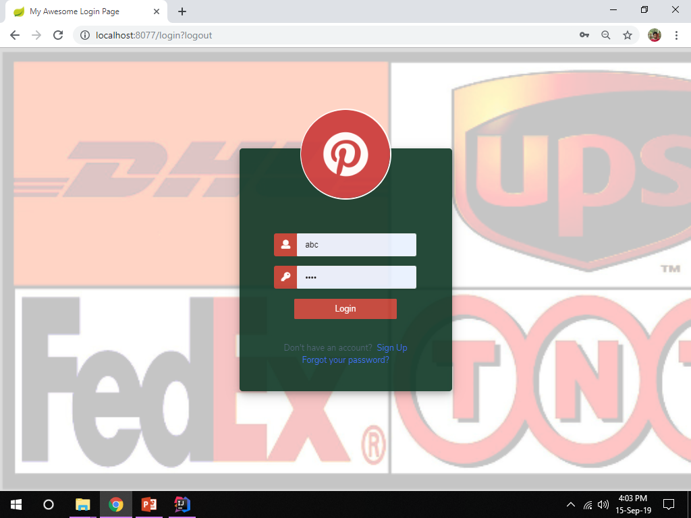

Slide 8
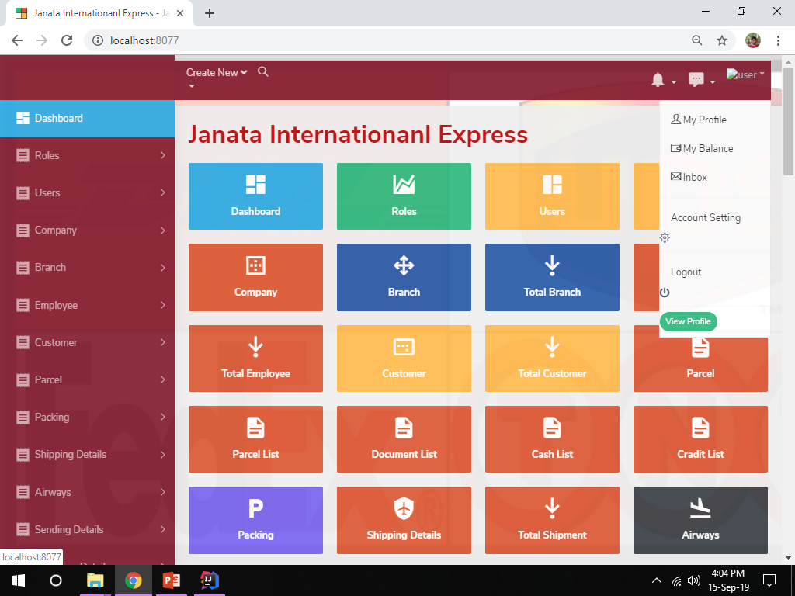

Slide 9
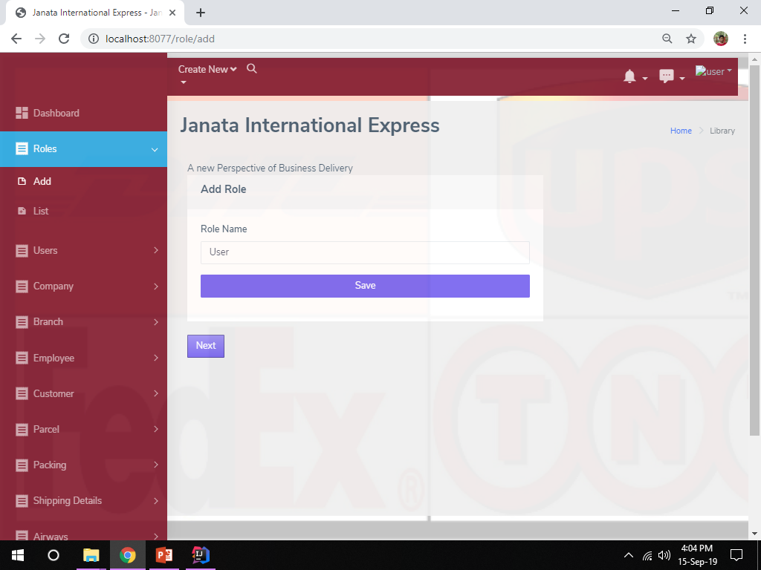

Slide 10
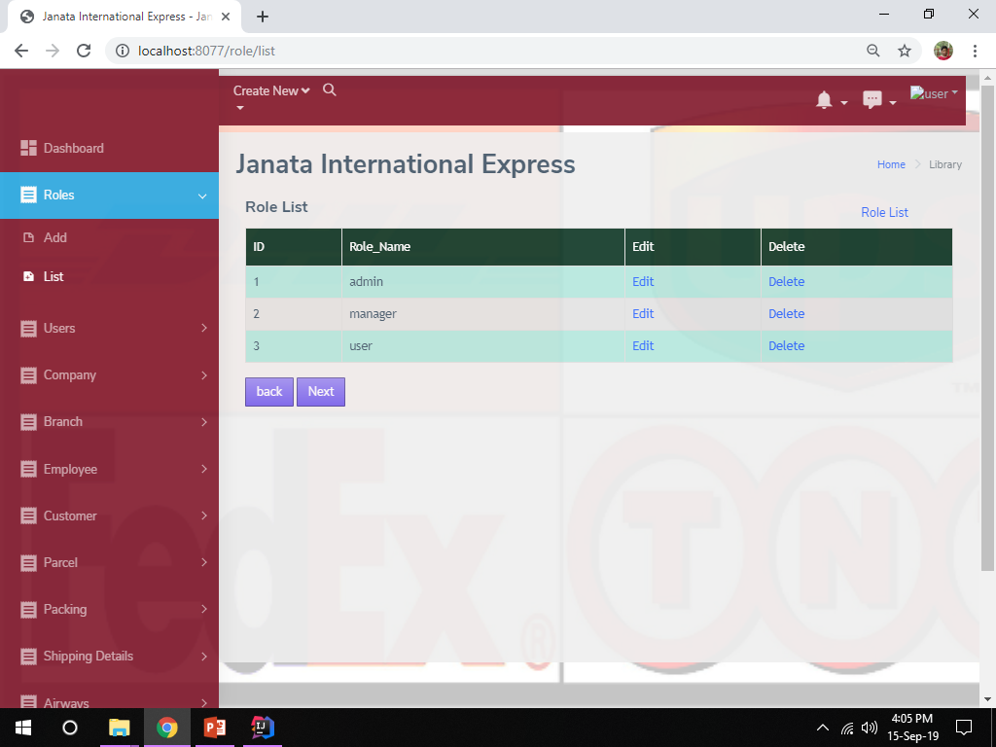

Slide 11
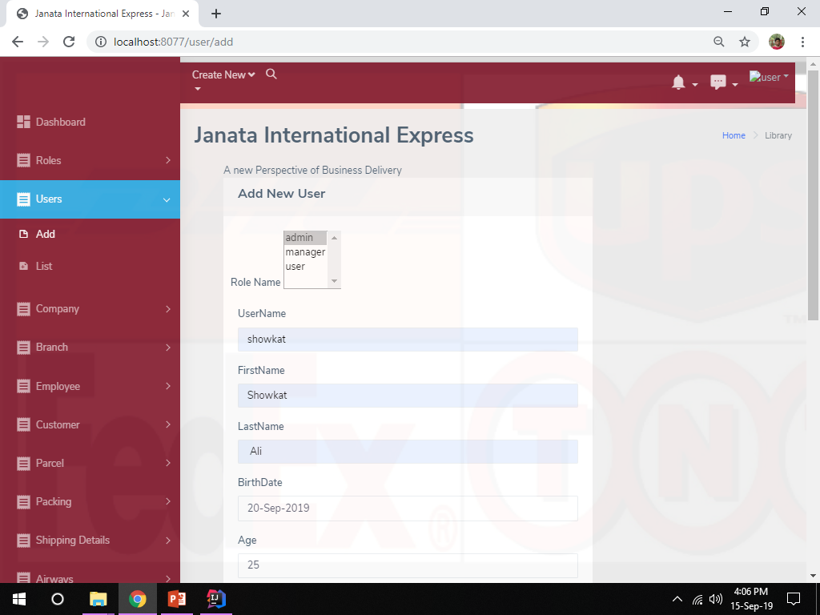

Slide 12
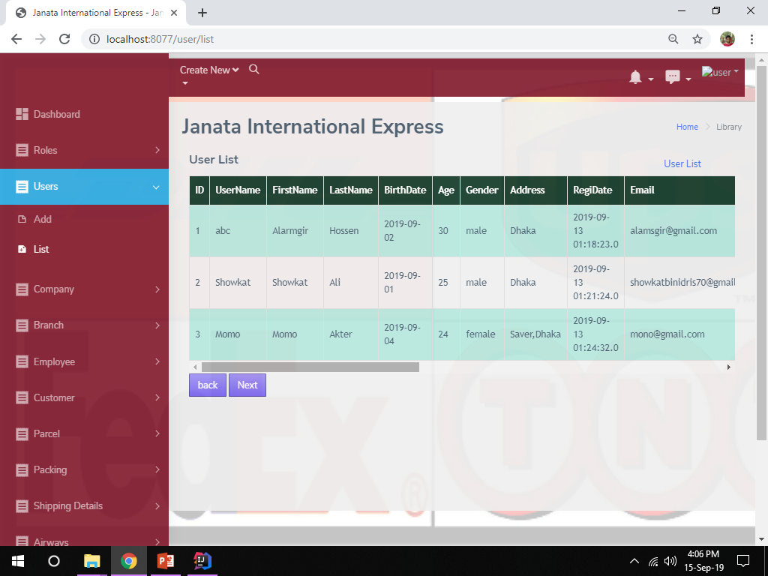

Slide 13
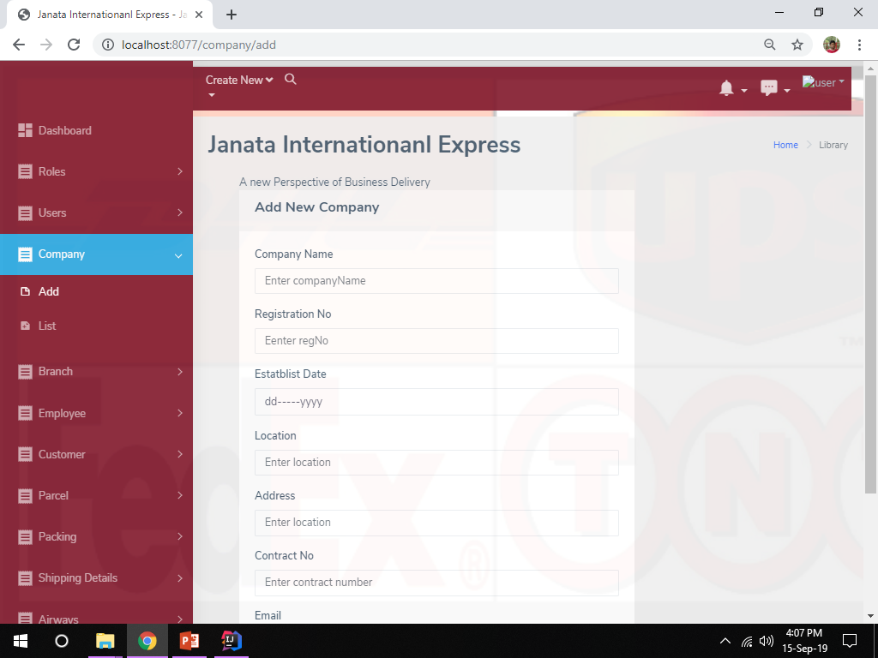

Slide 14
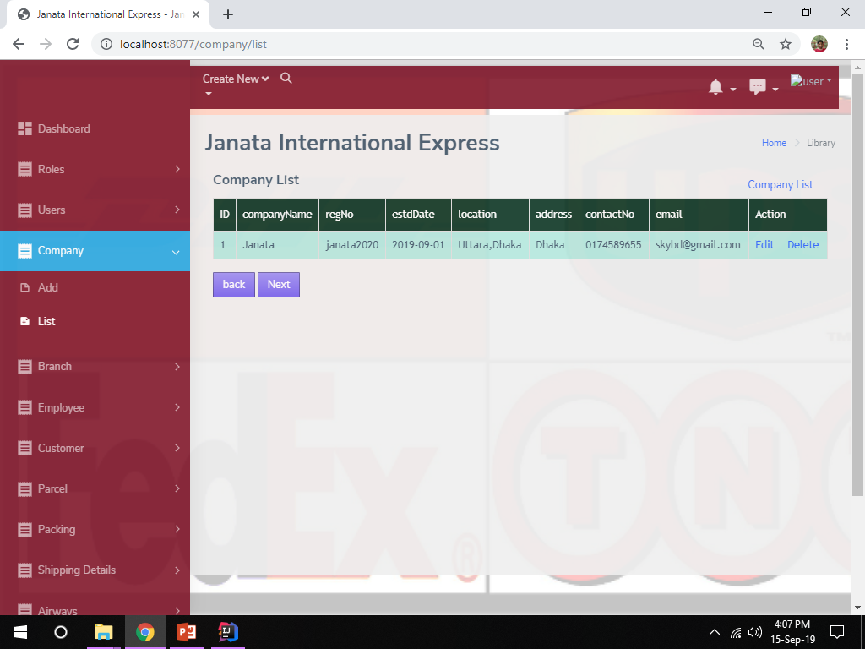

Slide 15
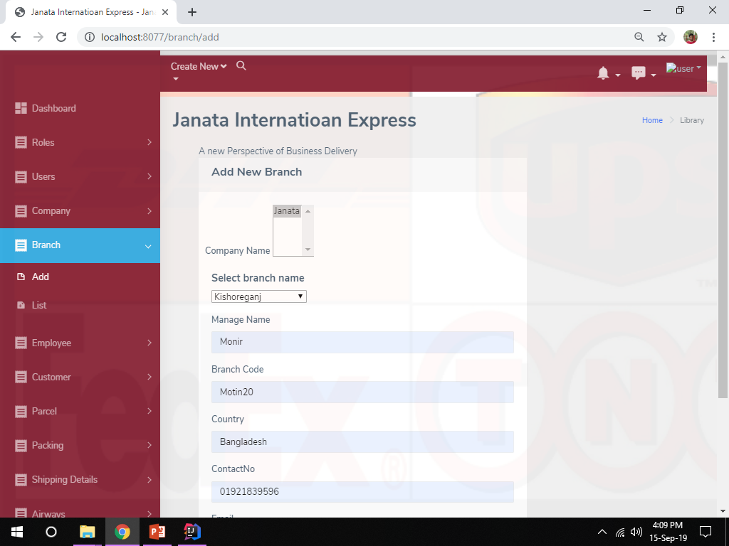

Slide 16
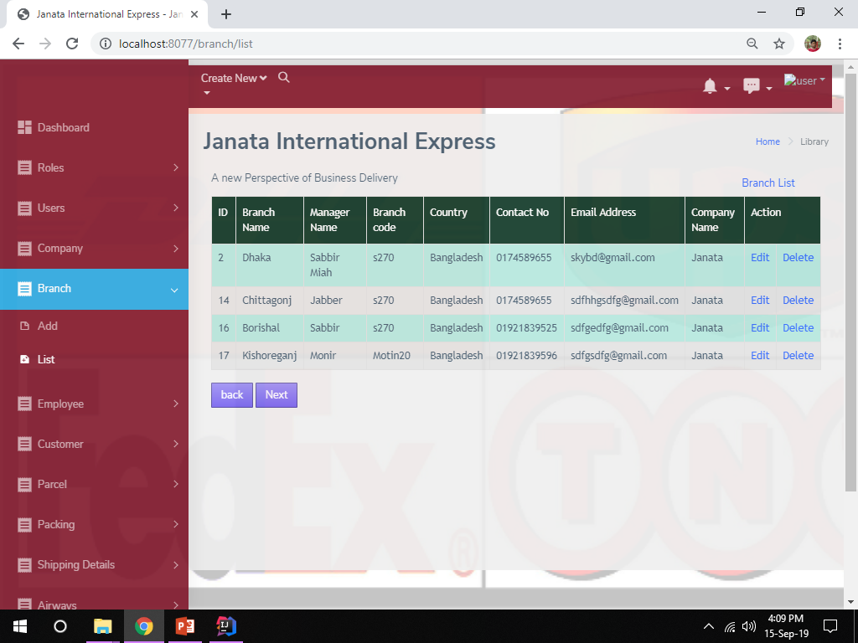

Slide 17
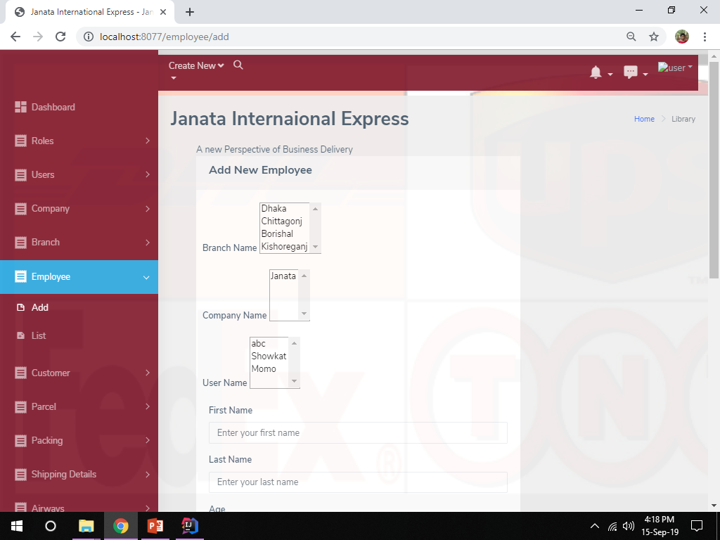

Slide 18
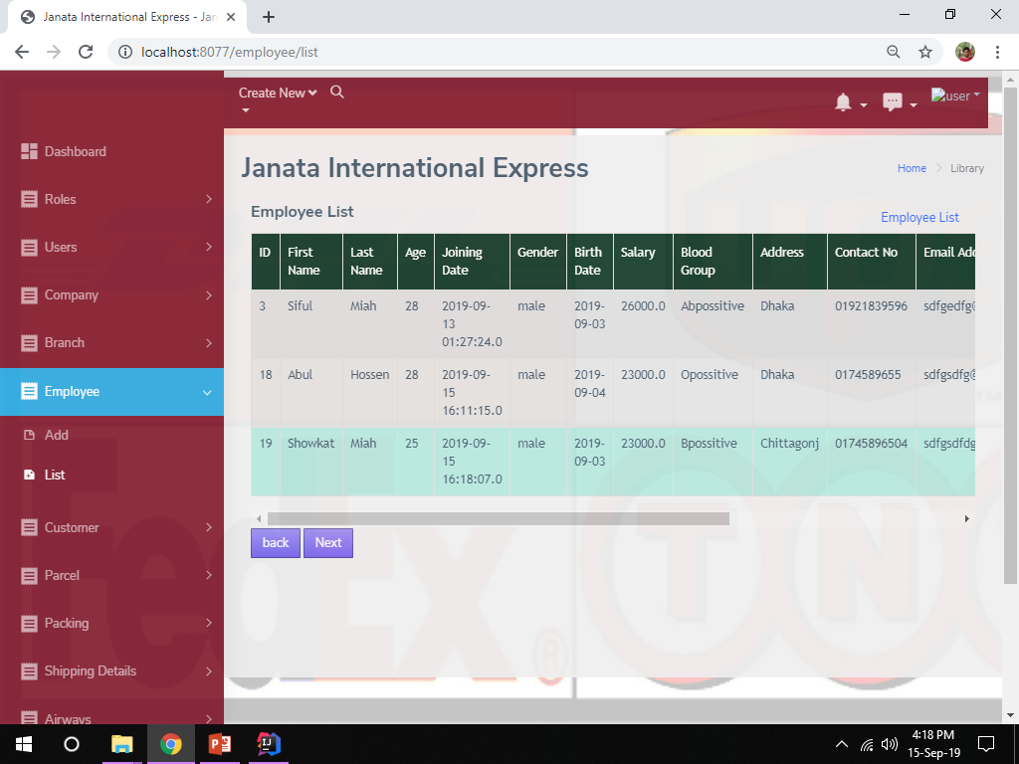

Slide 19
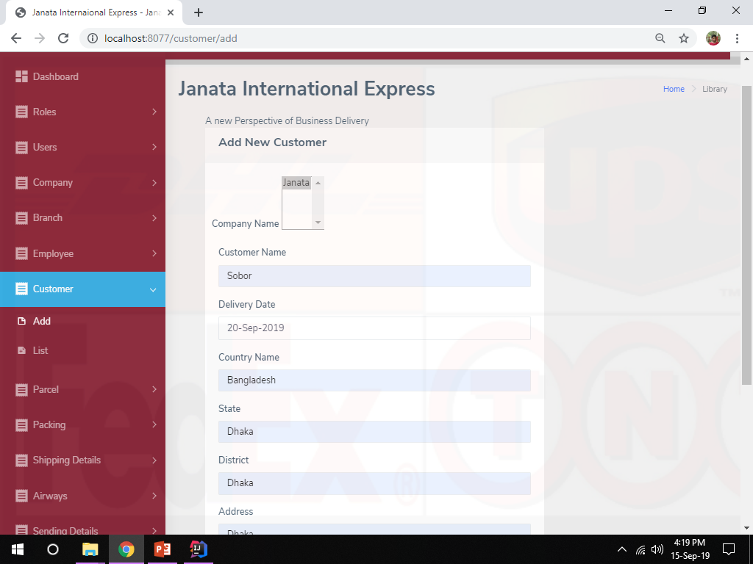

Slide 20
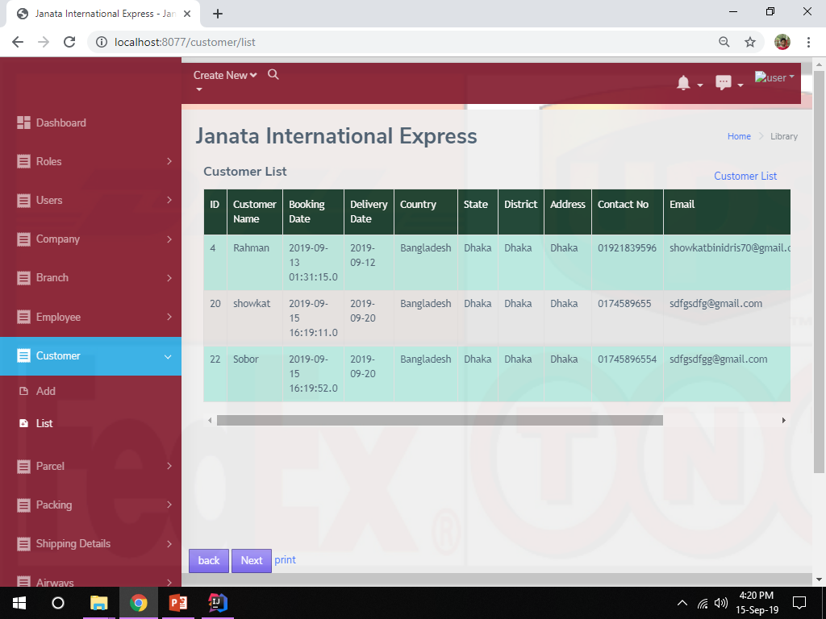

Slide 21
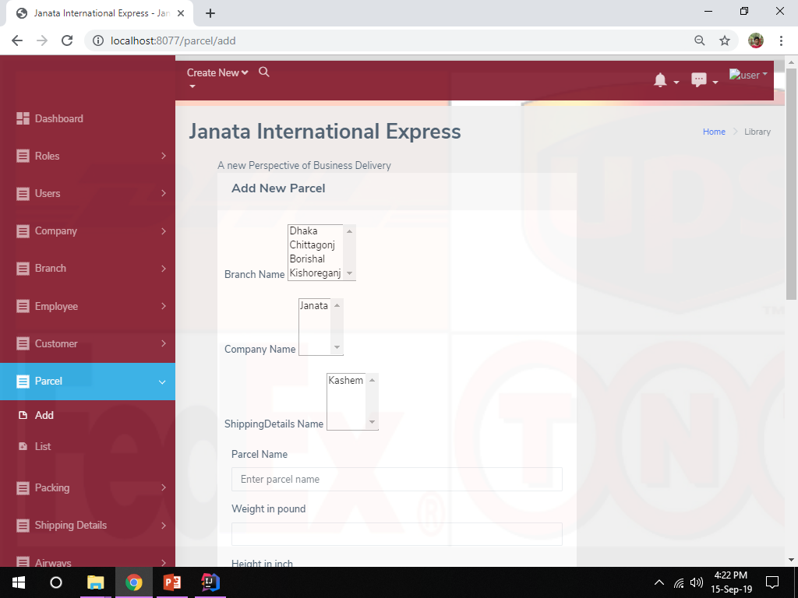

Slide 22
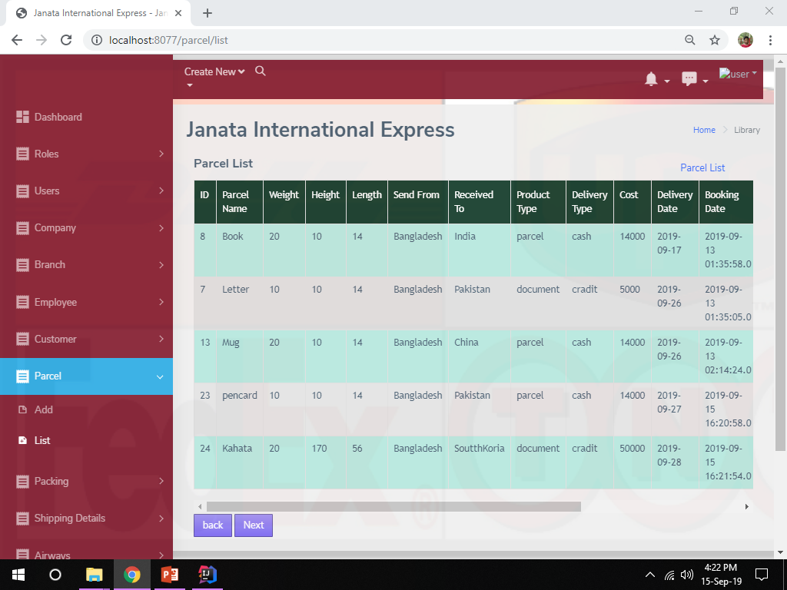

Slide 23
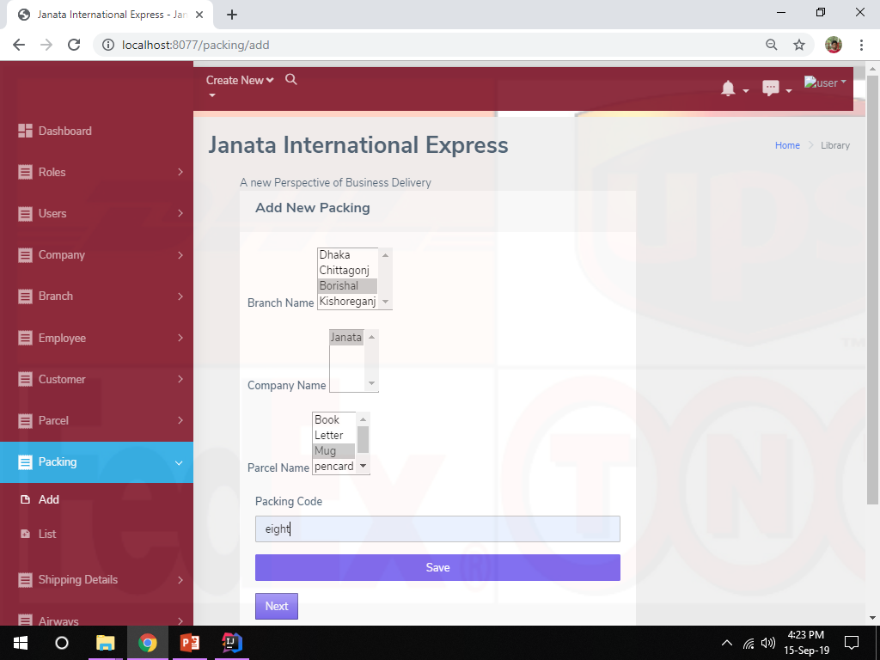

Slide 24
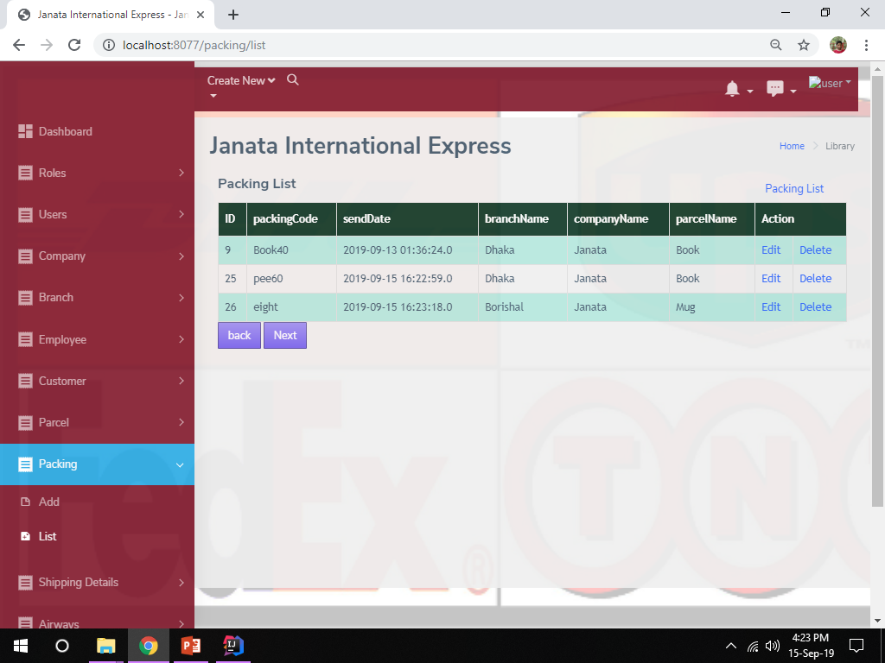

Slide 25
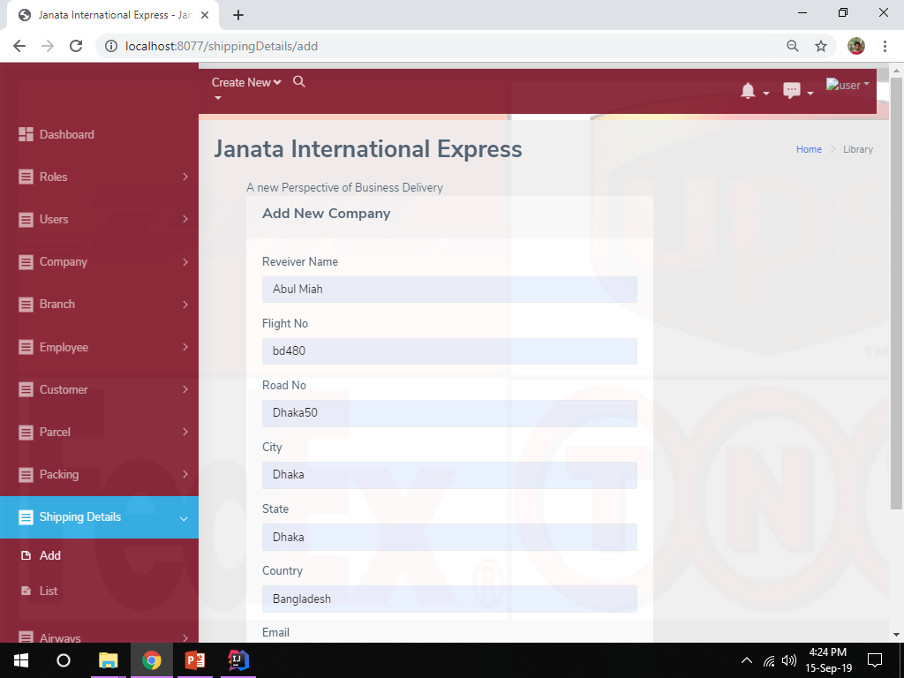

Slide 26
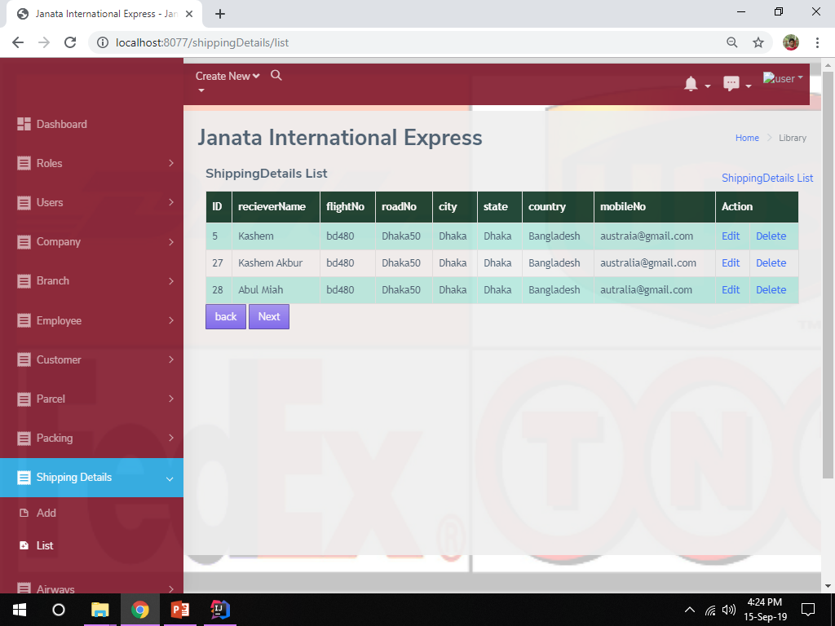

Slide 27
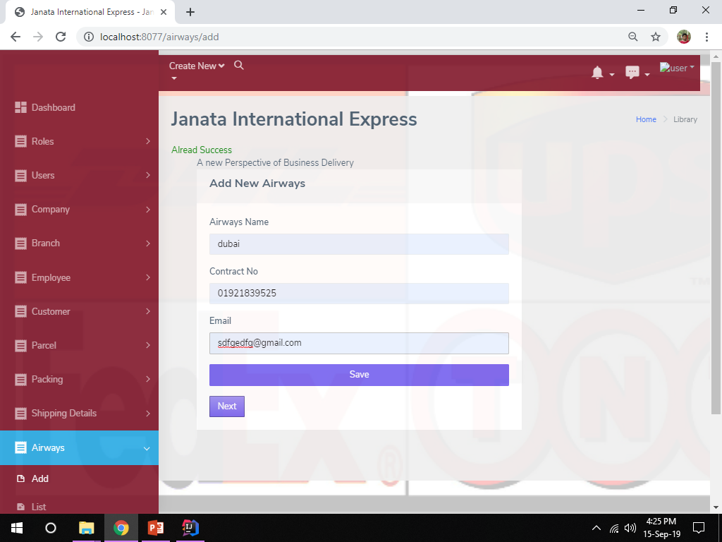

Slide 28
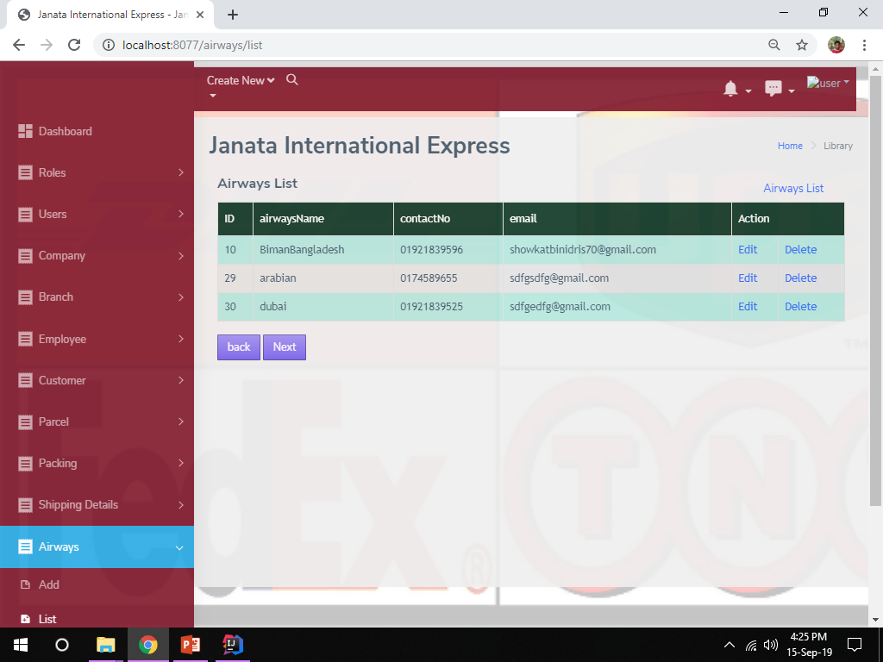

Slide 29
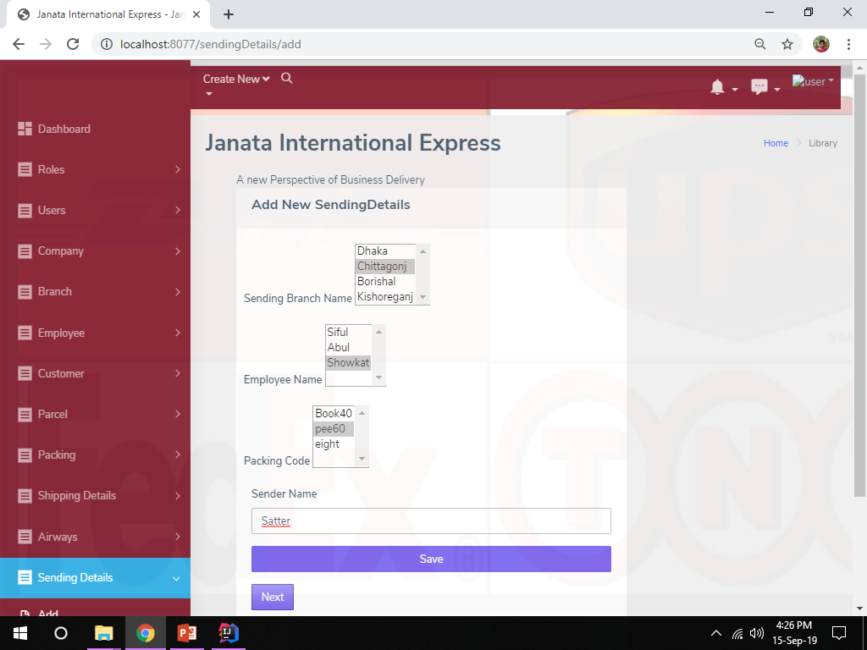

Slide 30
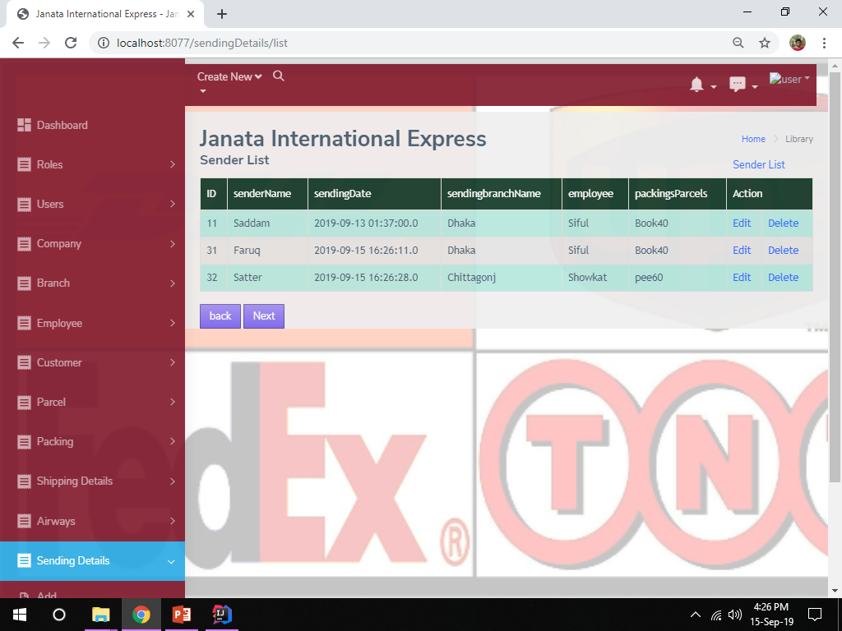

Slide 31
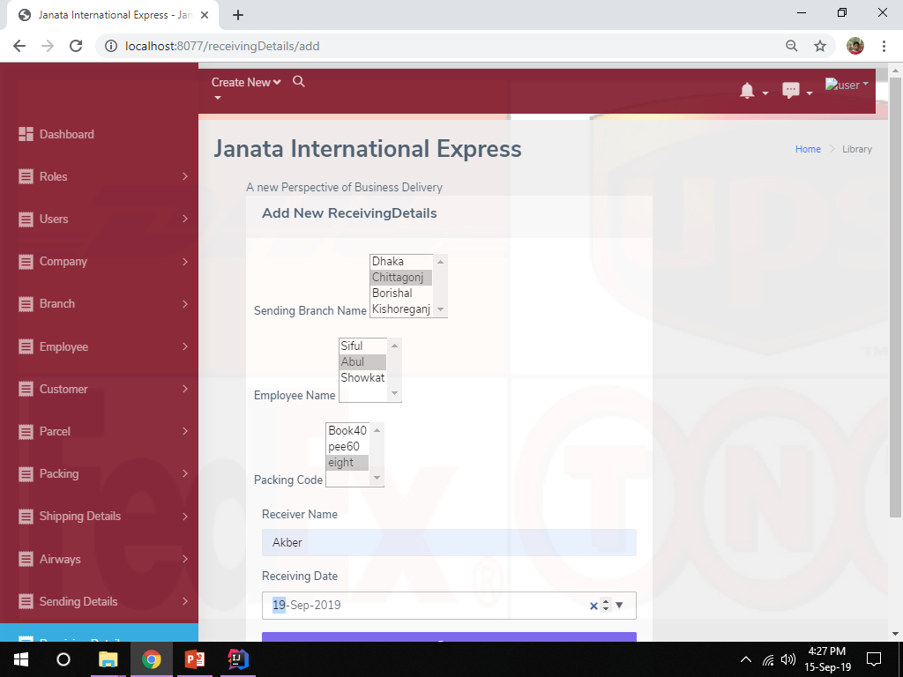

Slide 32
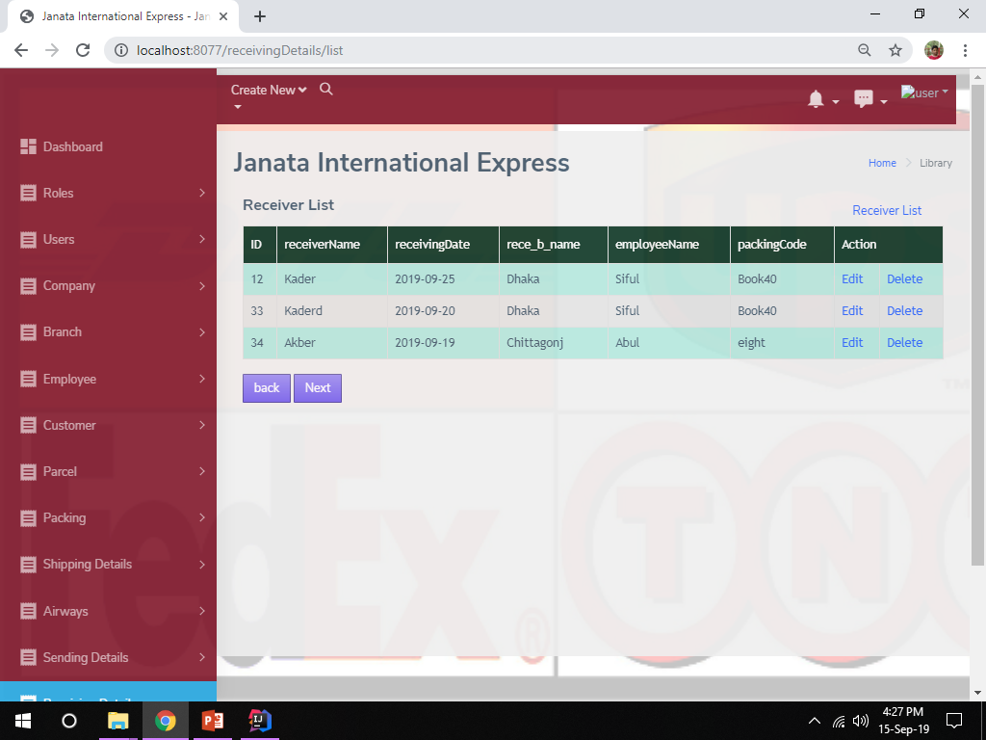

Slide 33
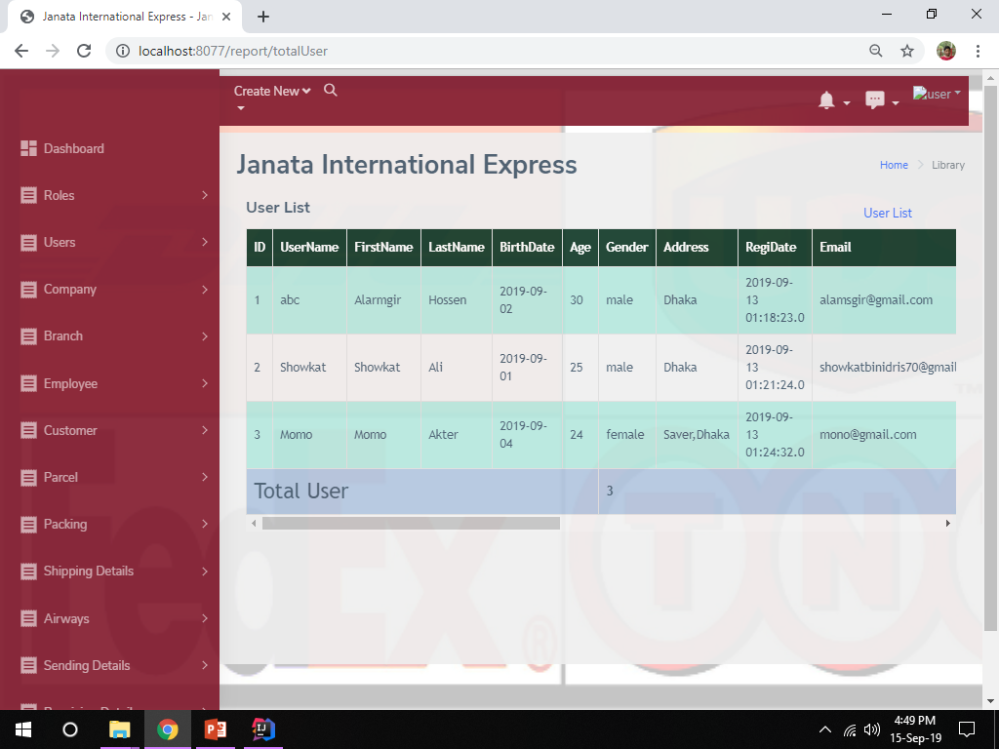

Slide 34
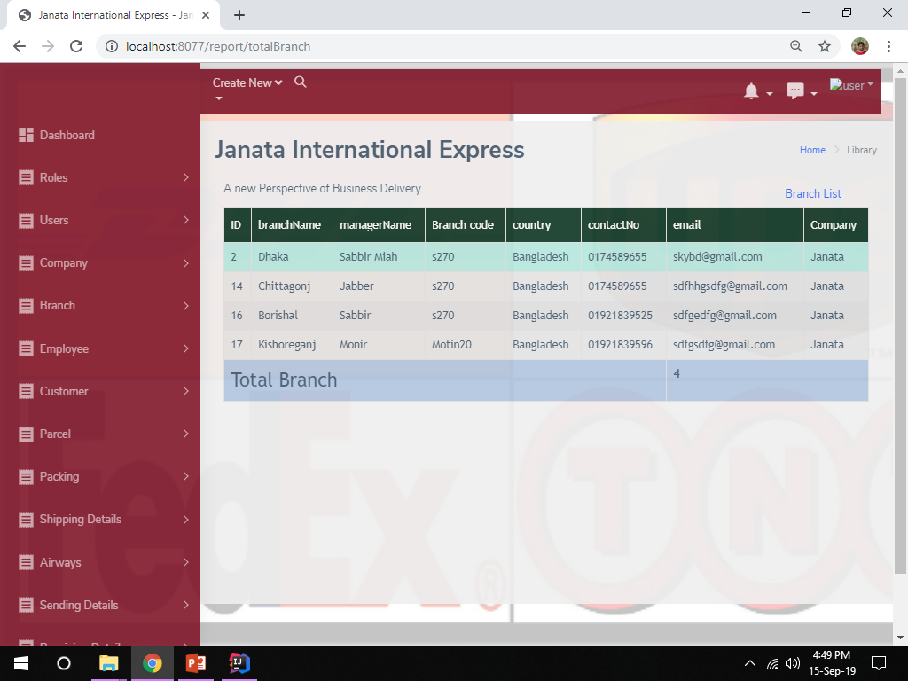

Slide 35
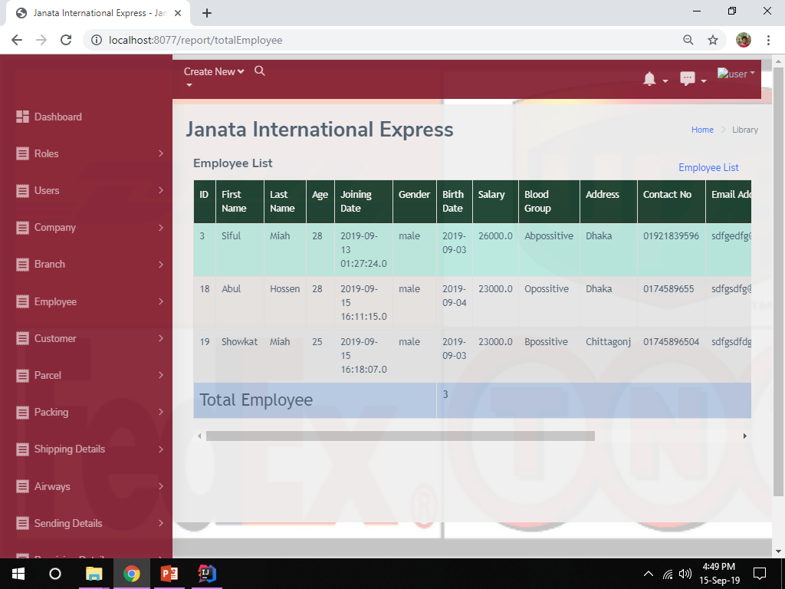

Slide 36
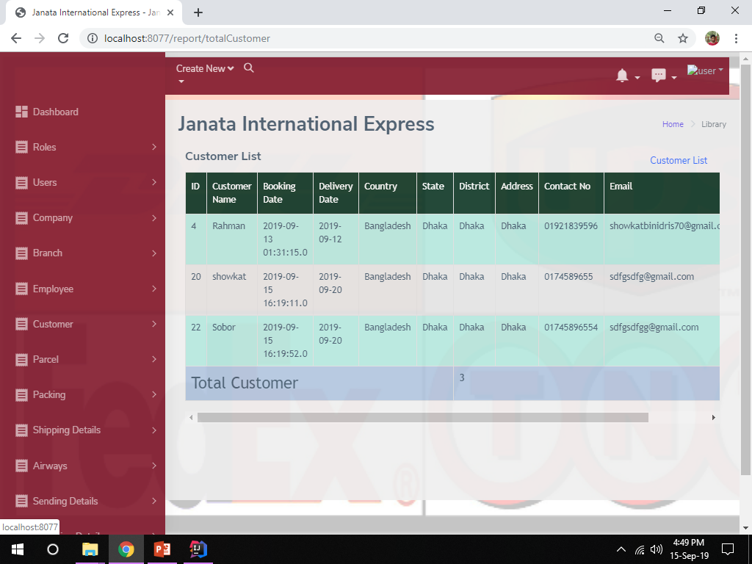

Slide 37
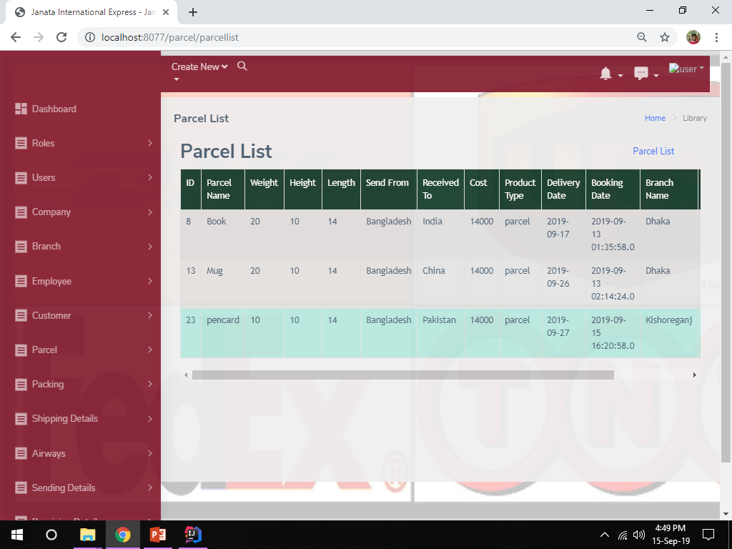

Slide 38
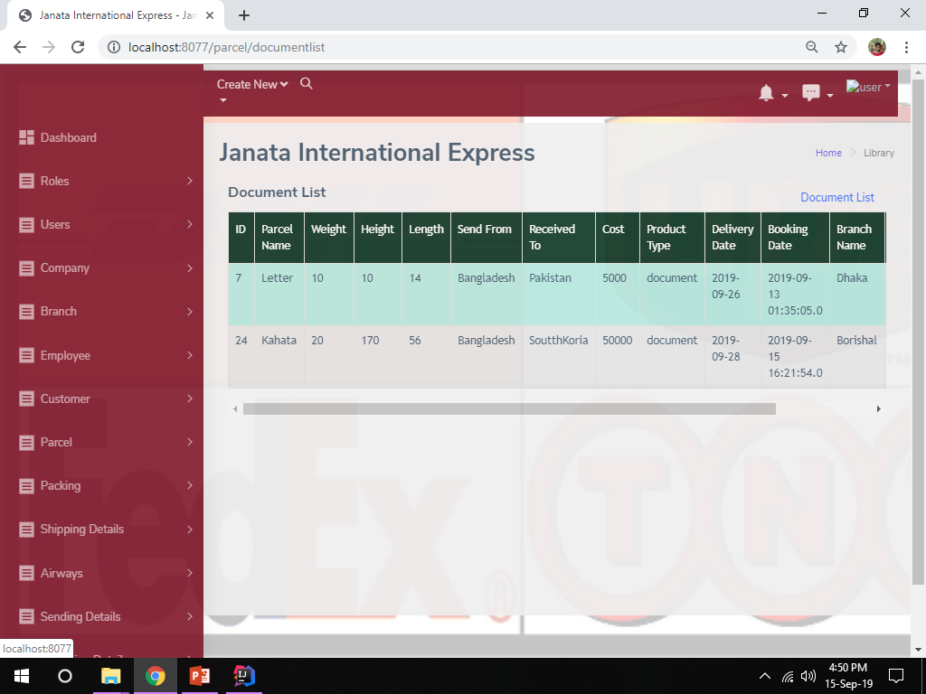

Slide 39
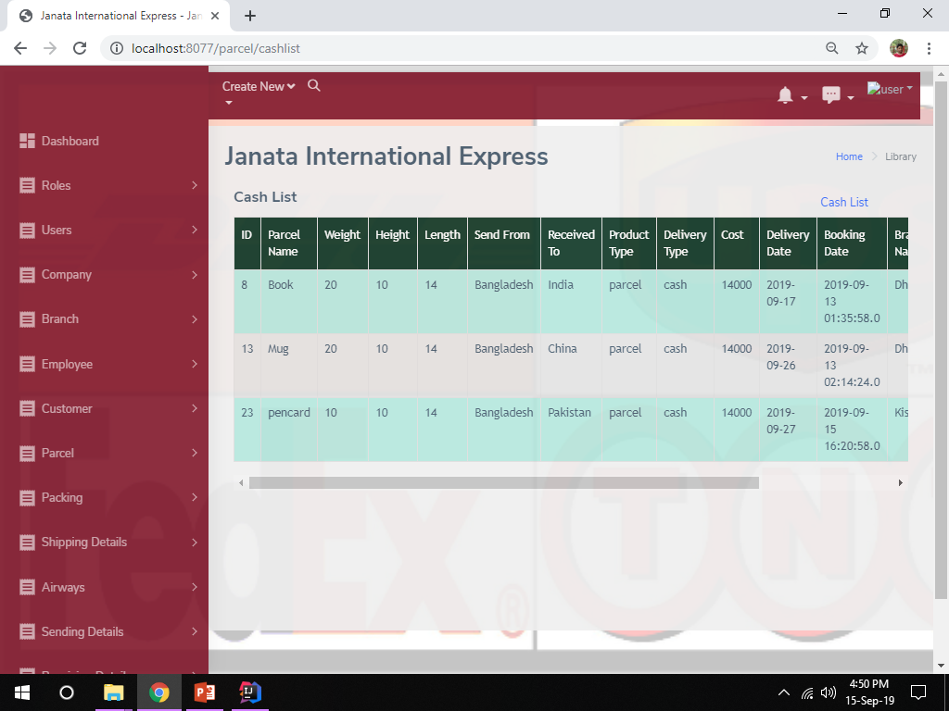

Slide 40
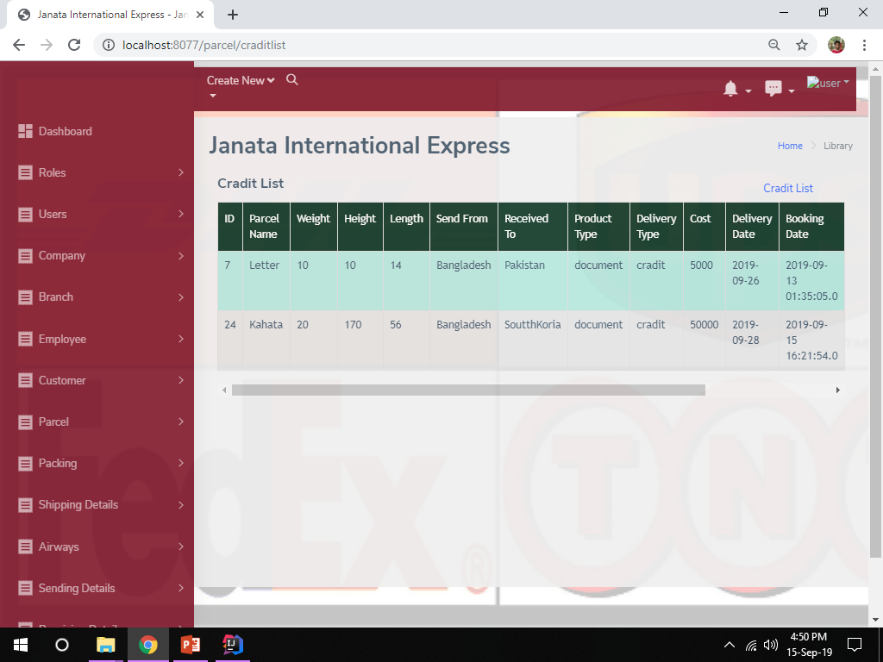

Slide 41
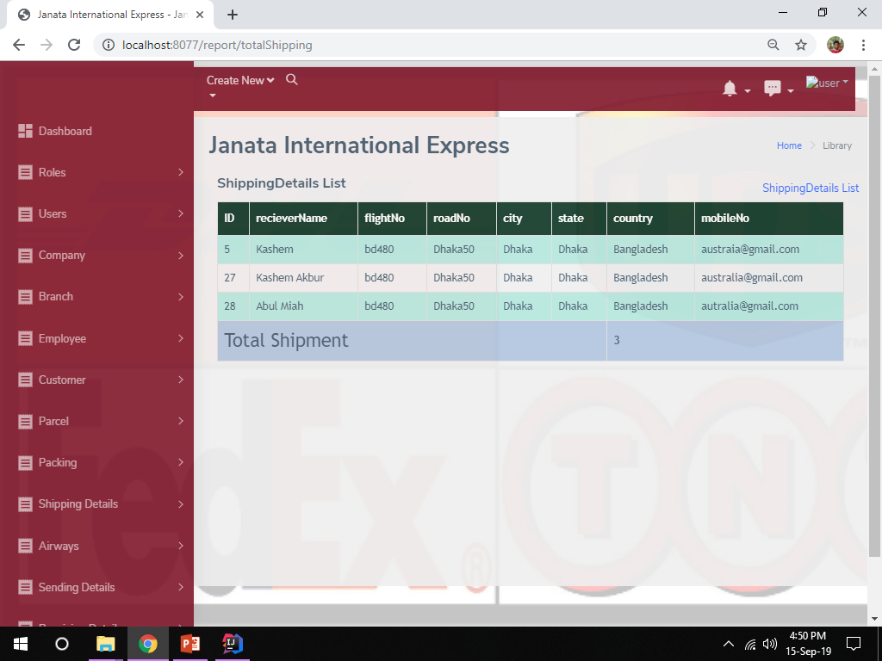

Slide 42
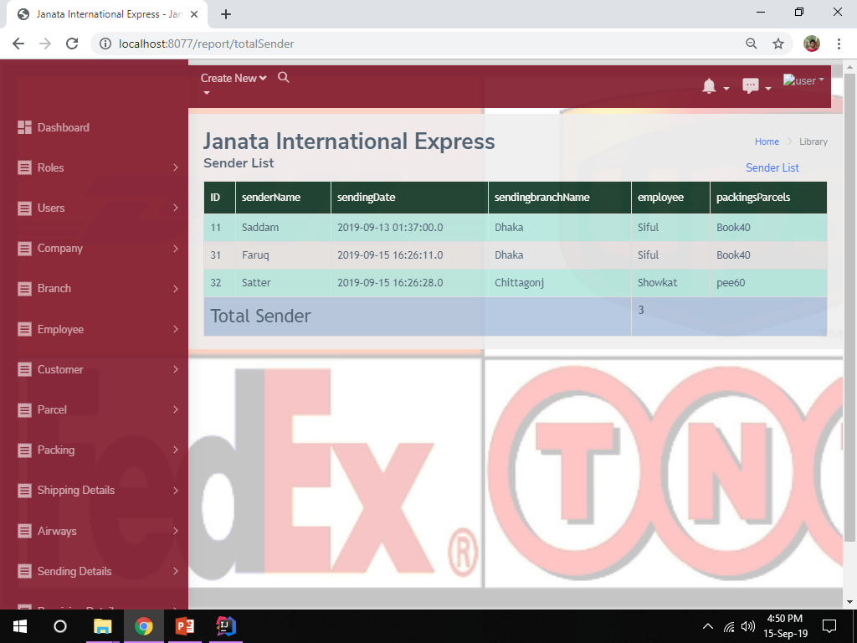

Slide 43
